Slide 1
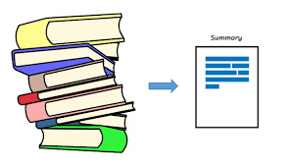
Text Summarization
Document/ Text reading
Short summary
Long Summary
Created by:
Rasika Gulhane
Mahesh Jadhav
Chaitanya Dave

Slide 2
Contents:
Introduction
Features
User Interface
Usage
Analysis
Model Implementations
Pegasus
Hugging Face BERT
Hugging face BART
Hugging face T5_base Model
Fine Tuning Hugging Face BART Model
REST API work
Findings
Docker & AWS EC2
Github
Conclusion

Slide 3
Introduction:
Text Summarization is Generative AI for research and document summarization is an advanced solution that utilizes natural language processing (NLP) and deep learning techniques to automatically generate concise and coherent summaries of lengthy documents quickly and efficiently. The application provides a user-friendly interface where users can input their text or upload a PDF document for summarization.
The summarization process can be customized based on the user's preference, with options for short or long summaries. It utilizes the Hugging Face library and the framework to provide a user-friendly interface for text summarization.

Slide 4
Features:
1. Text Placement:
- User can either paste or type the article text directly into the input textarea provided.
- The word count of the input text is dynamically displayed, giving users an idea of the text length.
2. Upload Document (PDF):
- User have the option to upload a PDF document for summarization.
- The uploaded PDF is processed, and the text content is extracted for summarization.
- The extracted text is displayed in the input textarea, allowing users to make modifications if needed.

Slide 5
Features:
3. Summary Type:
- User can choose between a short or long summary type based on their requirements.
- The selected summary type determines the level of detail in the summarized output.
4. Summarized Text:
- The application generates a summarized version of the input text using advanced natural language processing techniques.
- The summarized text is displayed in a readonly textarea, allowing users to easily view and copy the summary.
- The word count of the summarized text is dynamically displayed, providing users with the length of the summary.

Slide 6
Features:
5. Summarize Button:
- Clicking the "Summarize" button initiates the summarization process.
- A loading message is displayed during the summarization process to indicate progress.
- Upon completion, the summarized text is updated, and the word count is recalculated.
6. Technical Details:
- The web application is built using HTML, CSS, and JavaScript.
- It leverages the PDF.js library to extract text content from uploaded PDF documents.
- The text summarization process is handled through a server-side component that utilizes natural language processing algorithms.
- AJAX is used to send asynchronous requests to the server for summarization and receive the summarized text as a response.
- The application dynamically updates the word count of the input text and summarized text using JavaScript functions.

Slide 7
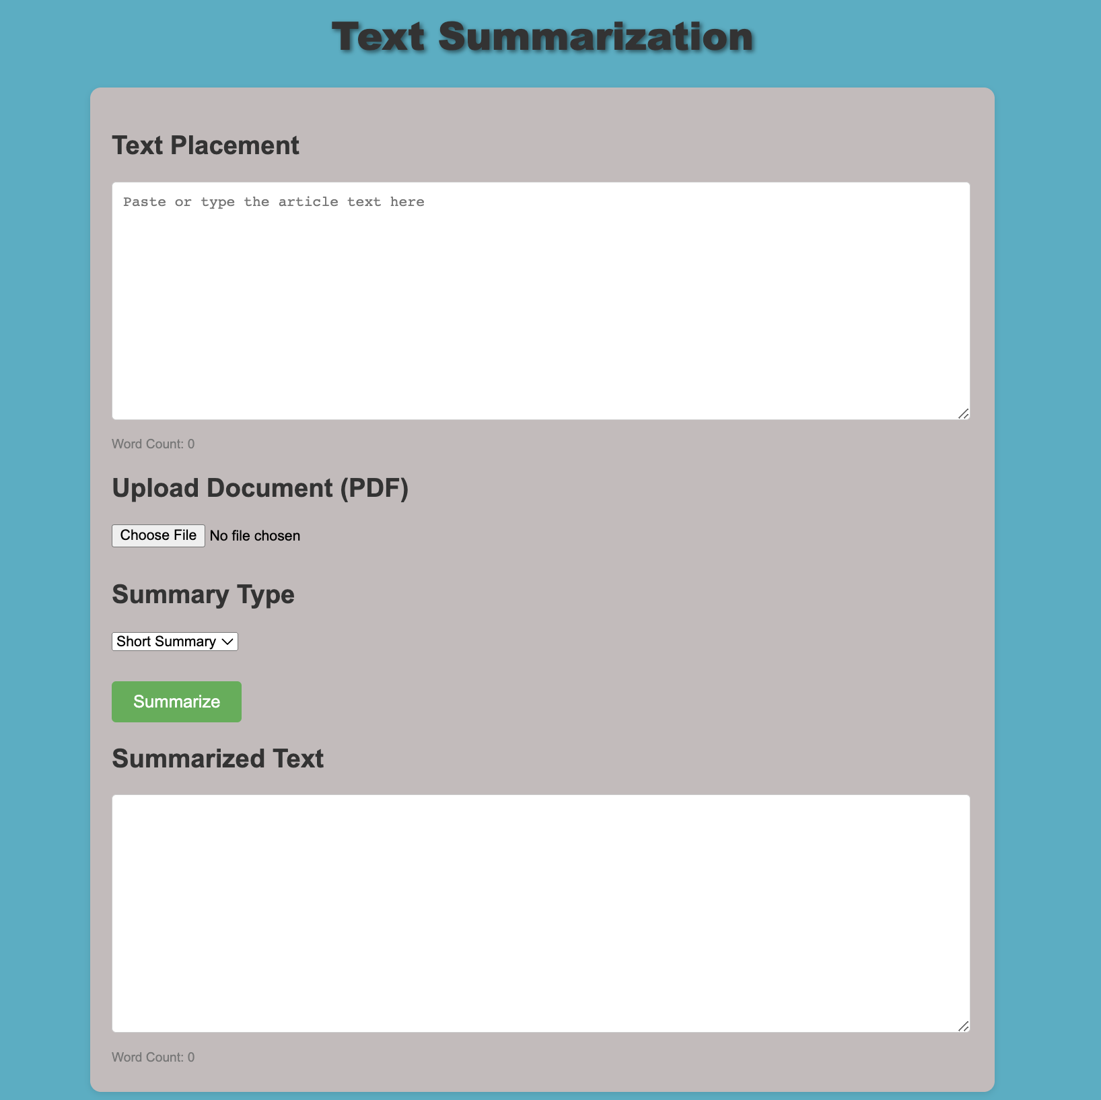
User Interface:

Slide 8
Usage:
Python 3.11.1
Anaconda 4.12
VScode IDE
Required Libraries
numpy
pandas
nltk
tensorflow
torch
transformers
pytorch-lightning
rouge
sentencepiece
scikit-learn
protobuf==3.20.0
accelerate
4. Laptop Configuration:
Windows 17 processor
Nvidia
GPU compatible
5. Github repository
https://github.com/Rasika-Gulhane/Document_Summarization
6. Docker Desktop
6. AWS EC2 cloud platform

Slide 9

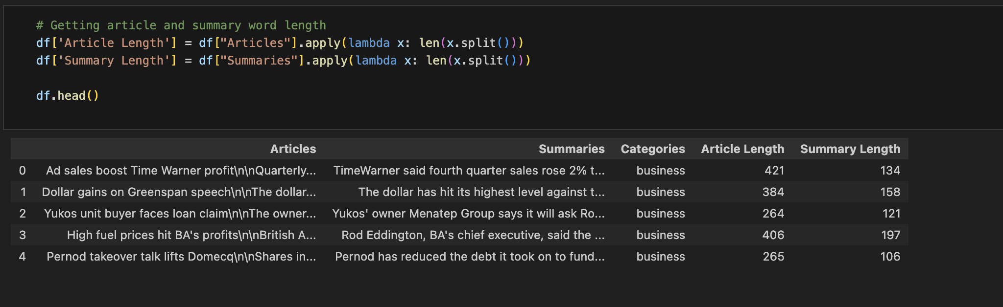
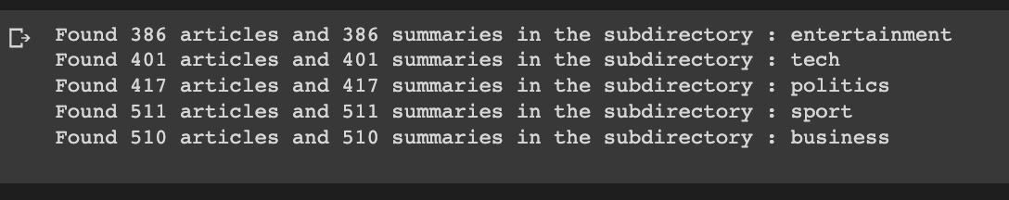
Analysis:
For BBC News articles: (short input text)

Slide 10
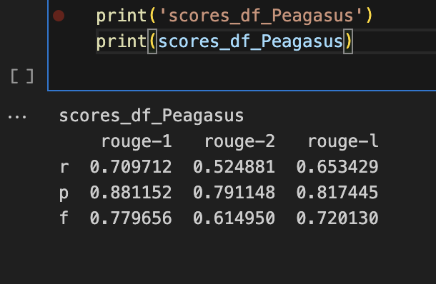
Pegasus Summarization
Summarization on BBC article using Pegasus library with
model_name = 'google/pegasus-cnn_dailymail'
Evaluation of actual summary vs generated summary using Rouge score.
(F1 score is considered)

Slide 11
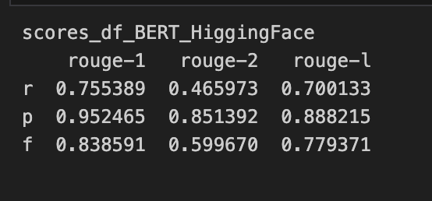
Hugging Face BERT Summarization
Summarization on BBC article using pipeline summarization from transformers with Hugging Face
Evaluation of actual summary vs generated summary using Rouge score.
(F1 score is considered)

Slide 12
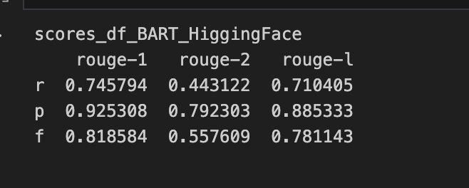
Hugging Face BART Summarization
Summarization on BBC article usind
model_name = "facebook/bart-large-cnn"
Evaluation of actual summary vs generated summary using Rouge score.
(F1 score is considered)
Since the average score is good for BERT and BART , Tried Fine tuning both with some parameters.

Slide 13
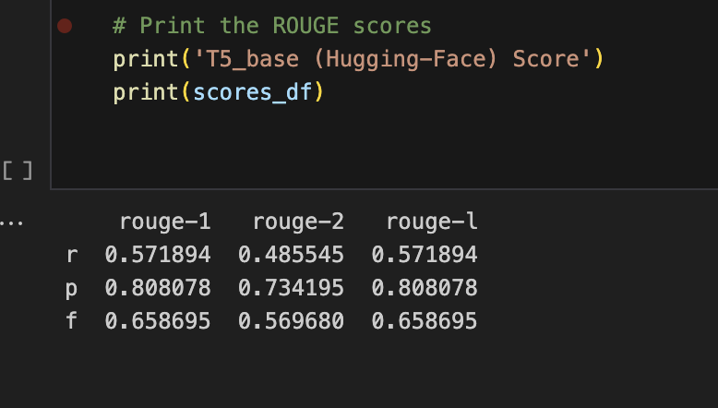
Hugging Face T5_base Summarization
Summarization on BBC article using PyTorch lightning library
For tokenizer use of MODEL_NAME = 't5-base'
Evaluation of actual summary vs generated summary using Rouge score.
(F1 score is considered)
Tried manipulating epoches but taking longer time to execute.
Decreasing epoches affects score

Slide 14
Fine Tune Hugging face BART model
For better Accuracy and fastest result using device function of torch library
device = torch.device("cuda" if torch.cuda.is_available() else "cpu")
Model Used:
model_name = "sshleifer/distilbart-cnn-12-6"
summarizer = pipeline("summarization", model=model_name, revision="a4f8f3e")
Split the text into chunks of maximum 600 words
max_words = 600
chunks = [text[i:i+max_words] for i in range(0, len(text), max_words)]
Chunks and size varies depending on received input for Short and Long summary.

Slide 15
API process:
GPU Compatibility:
The application checks for the availability of a GPU for accelerated processing. If a GPU is available, it is utilized for enhanced performance.
Code Structure:
The application code is written in Python, utilizing Flask Restful API for the web framework.
Within the function, the Hugging Face summarization pipeline is loaded using the specified model name and revision.
The transformers library from Hugging Face is used for text summarization.
The application code is structured into different routes, including the home route and the summary route.
To efficiently process large texts, the input text is divided into chunks of maximum 600 words. Each chunk is then passed through the summarization pipeline separately.

Slide 16
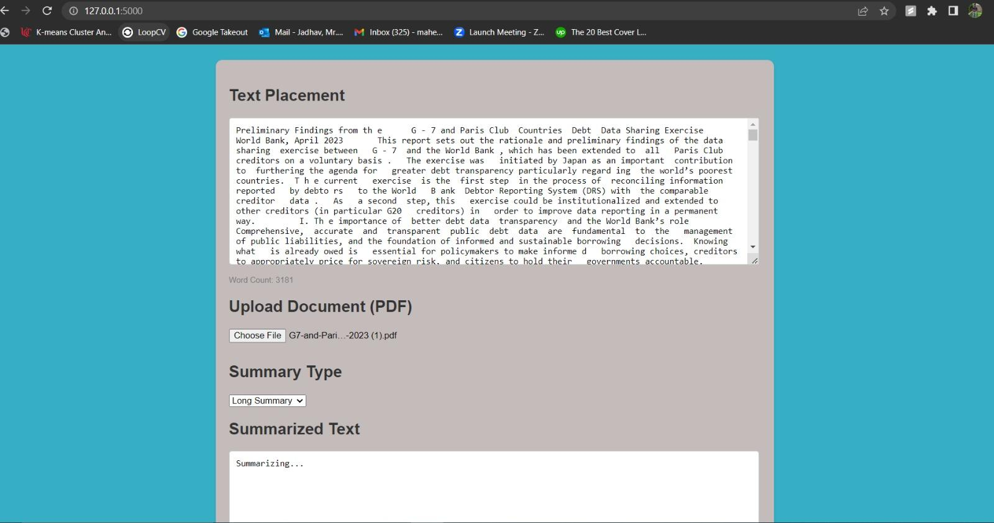
Document reading
Here, we can replace the text or we can upload any longer document. Input text has not limit of word count.

Slide 17
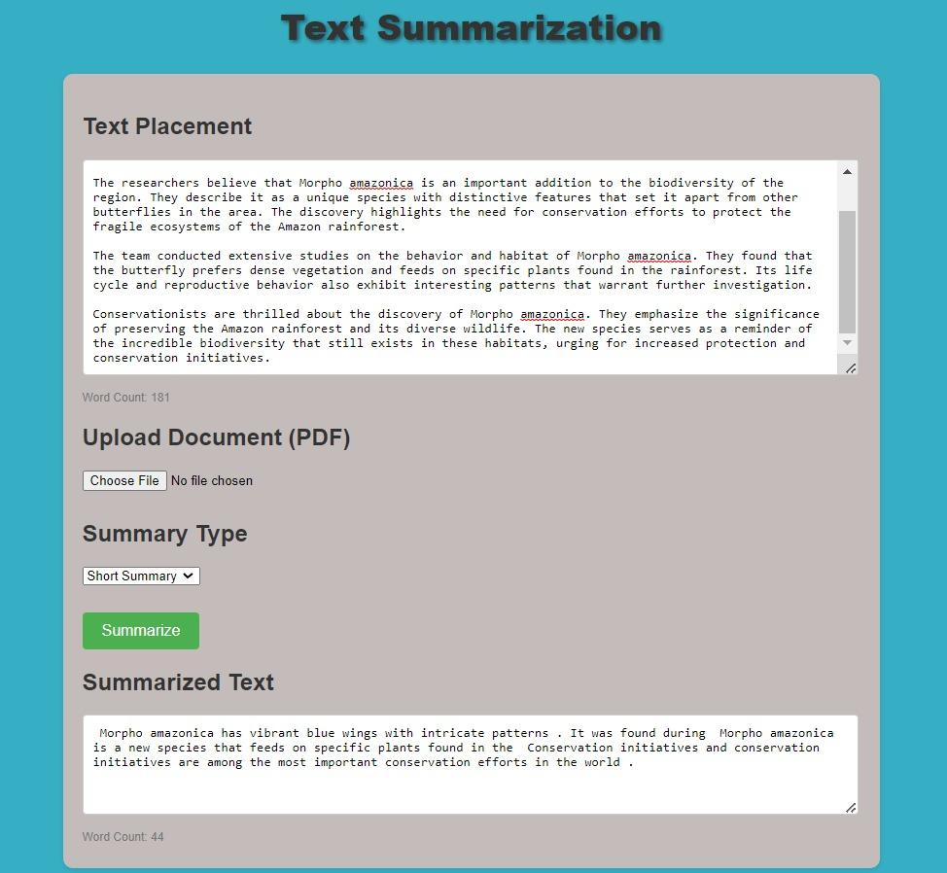
Findings:
Summarization result depends on what type of summary user has selected short/long.
With shorter document of less than 1000 words :
Short summary takes approx. 10 sec. on local system.
Long summary takes approx. 15 sec.

Slide 18
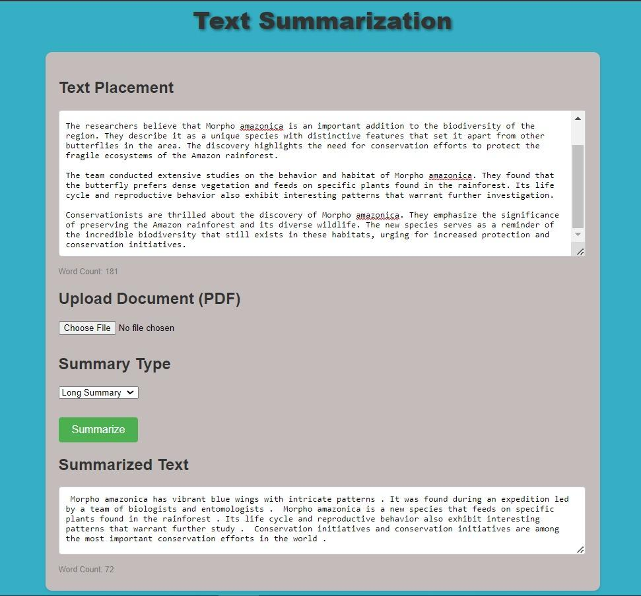
Findings:
Greater the text greater is time taken for generating text summary.
If text more than 600 words get process with chunking of each batches of 600 words.

Slide 19
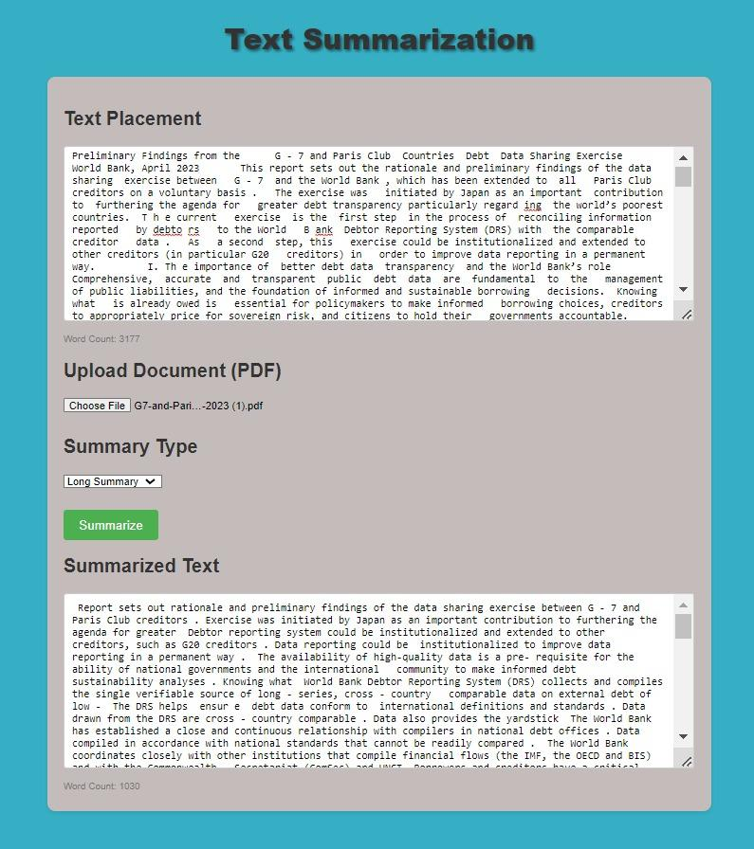
Findings:
With longer document considering around 4000+ :
Short summary takes approx. 2 min. on local system it can be reduced over cloud with fast processor
Long summary takes approx. 3 min.

Slide 20
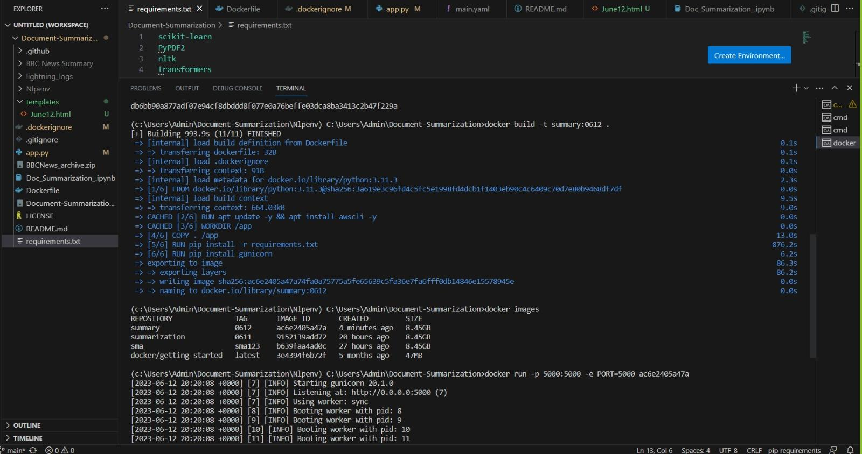
Docker:
A docker image for future use and updation within project

Slide 21
ReadMe Instruction to Run the Project:
Clone the project using link https://github.com/Rasika-Gulhane/Document_Summarization.git
open in IDE (recommended VSCODE)
open terminal of project
Create Python/Conda Environment
Command to run:
pip install -r requirements.txt
python app.py
click the link in terminal output
or
follow link http://127.0.0:5000

Slide 22
Conclusion:
The Text Summarization project provides a convenient and efficient solution for summarizing large amounts of text. Whether it's academic papers, news articles, legal documents or any other type of lengthy text, users can easily obtain concise summaries tailored to their needs. With its user-friendly interface and customizable summarization options, the Text Summarization application is a valuable tool for enhancing productivity and extracting key information from voluminous texts.
The text summarization uses ‘hugging face BART model’ which provides a convenient way to generate summaries and offers flexibility with short and long summary modification as per input received and it utilizes GPU acceleration for faster processing. The application can be further customized and enhanced to meet specific requirements.
Note: This report provides an overview of the application's features and functionality based on the provided code and HTML page. Further improvements and refinements can be made as per specific project requirements.

